Slide 1
PHYS4260 Quantum Mechanics II Spring 2025
Time Dependent Perturbation Theory

Slide 2
Outline
Quantum Dynamics
Two-level systems
Time dependent perturbation theory

Slide 3


100 Year of Quantum Mechanics
In 2025 we celebrate the 100th anniversary of the development of Quantum Mechanics.
QM, its developments and applications have had enormous impact not only in physics but also on numerous
other disciplines of science and engineering and technology. In recognition of these facts, the United Nations
proclaimed 2025 as the International Year of Quantum Science and Technology.
The year 2025 also marks 50 years for the Standard Model. The Standard Model is of course based on gauge
theories which are quantum field theories which, in turn, are based on quantum mechanics plus special relativity.
Since we are in the 2024-2025 academic year, it is also notable that 2024 marked 60 years of the quark model,
the Higgs mechanism, and CP violation.
Interesting resources:
https://physicstoday.scitation.org/topic/quantum-world.
APS website (https://www.aps.org/about/news/2025/01/welcome-international-year-quantum) provides a great summary of the quantum anniversary, along with links to various online events and resources.
Quantum 2025: https://quantum2025.org/.

Slide 4
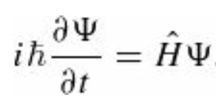
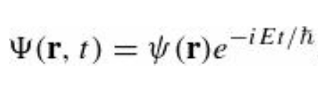
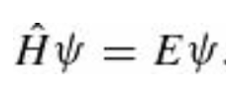
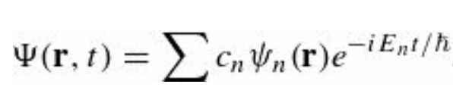
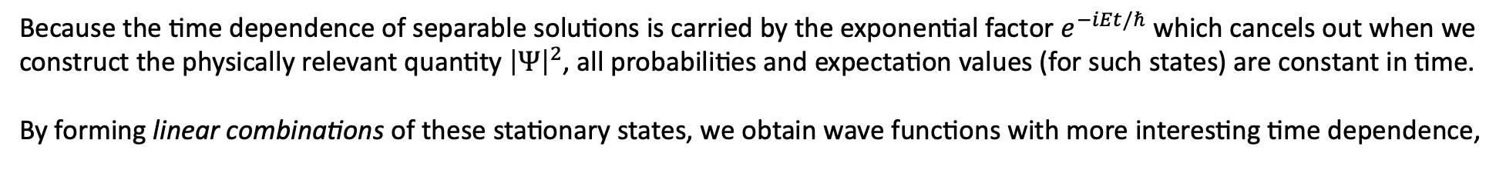
Quantum Dynamics
So far, practically everything we have done belongs to the subject that might properly be called quantum statics, in which the potential energy function is independent of time $V\left(r,t\right)=V(r)$. In that case the (time-dependent) Schrödinger equation,
can be solved by separation of variables:
where $ψ(r)$ satisfies the time-independent Schrödinger equation,
Because the time dependence of separable solutions is carried by the exponential factor $e^{−iEt/ℏ}$ which cancels out when we construct the physically relevant quantity ${\left|Ψ\right|}^{2}$, all probabilities and expectation values (for such states) are constant in time.
By forming linear combinations of these stationary states, we obtain wave functions with more interesting time dependence,
but even then, the possible values of the energy $E_{n}$ and their respective probabilities ${\left|c_{n}\right|}^{2}$, are constant.

Slide 5
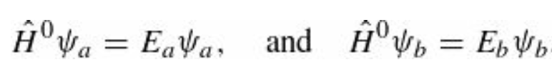
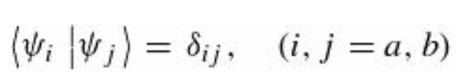
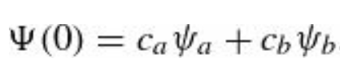
Quantum Dynamics
If we want to allow for transitions (quantum jumps, as they are sometimes called) between one energy level and another, we must introduce a time-dependent potential (quantum dynamics).
There are precious few exactly solvable problems in quantum dynamics. However, if the time-dependent part of the Hamiltonian is small (compared to the time-independent part), it can be treated as a perturbation.
The main purpose of what follows is to develop time-dependent perturbation theory and study its most important application: the emission or absorption of radiation by an atom.
Two-level Systems
To begin with, let us suppose that there are just two states of the (unperturbed) system $ψ_{a}$ and $ψ_{b}$. They are eigenstates of the unperturbed Hamiltonian $H^{(0)}$
and they are orthonormal:
Any state can be expressed as a linear combination of them; in particular,

Slide 6
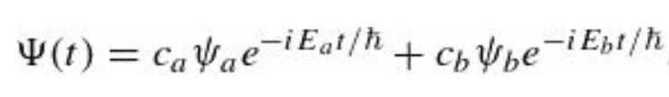
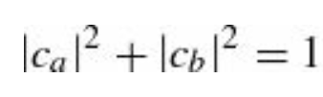
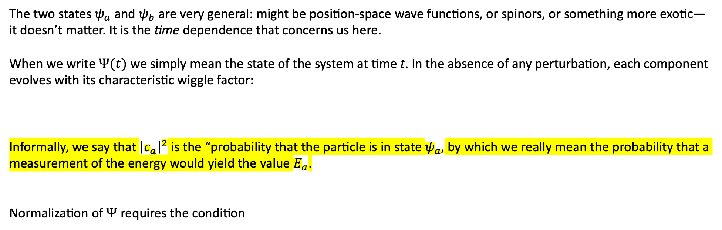
Two-level systems
The two states $ψ_{a}$ and $ψ_{b}$ are very general: might be position-space wave functions, or spinors, or something more exotic—it doesn’t matter. It is the time dependence that concerns us here.
When we write $Ψ(t)$ we simply mean the state of the system at time t. In the absence of any perturbation, each component evolves with its characteristic wiggle factor:
Informally, we say that ${\left|c_{a}\right|}^{2}$ is the “probability that the particle is in state $ψ_{a},$ by which we really mean the probability that a measurement of the energy would yield the value $E_{a}$.
Normalization of $Ψ$ requires the condition

Slide 7
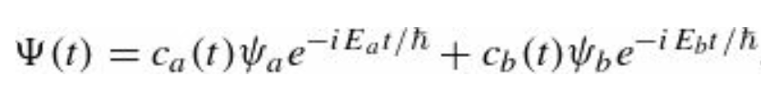
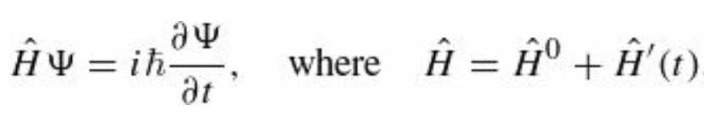
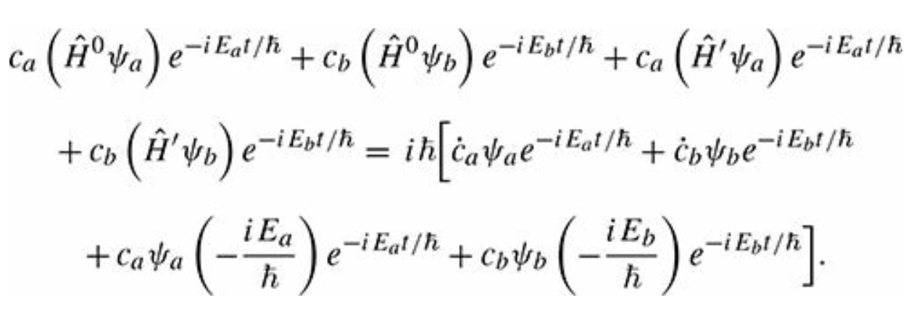
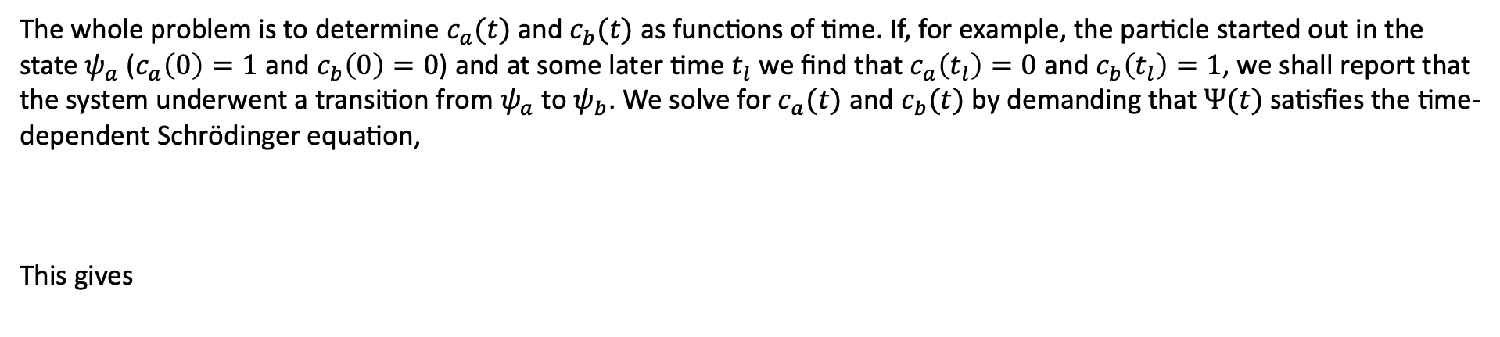
The perturbed system
Now suppose we turn on a time-dependent perturbation, $\hat{H}′(t)$. Since $ψ_{a}$ and $ψ_{b}$ constitute a complete set,
$Ψ(t)$ can be expressed as a linear combination of them, with the difference that now $c_{a}$ and $c_{b}$ are $c_{a}(t)$ and $c_{b}(t)$
The whole problem is to determine $c_{a}(t)$ and $c_{b}(t)$ as functions of time. If, for example, the particle started out in the state $ψ_{a}$ ($c_{a}\left(0\right)=1$ and $c_{b}\left(0\right)=0$) and at some later time $t_{l}$ we find that $c_{a}\left(t_{l}\right)=0$ and $c_{b}\left(t_{l}\right)=1$, we shall report that the system underwent a transition from $ψ_{a}$ to $ψ_{b}$. We solve for $c_{a}(t)$ and $c_{b}(t)$by demanding that $Ψ(t)$satisfies the time-dependent Schrödinger equation,
This gives

Slide 8
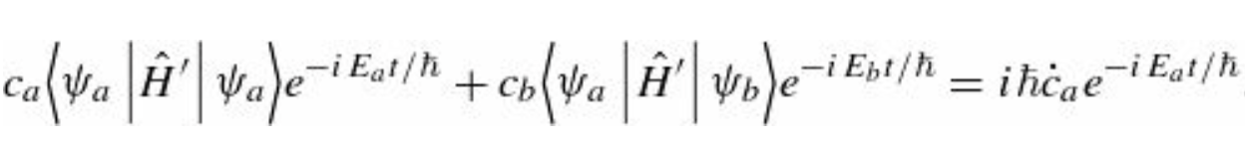
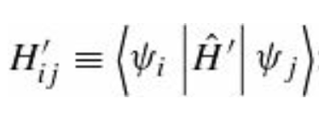
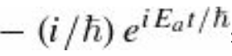
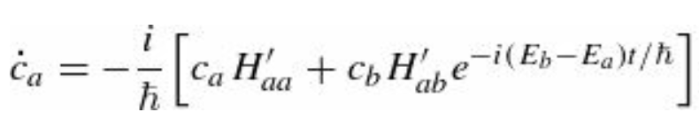
The perturbed system
The first two terms on the left cancel the last two terms on the right, and hence
To isolate ${\dot{c}}_{a}$ we use the standard trick: Take the inner product with $ψ_{a}$ and exploit the orthogonality of $ψ_{a}$ and $ψ_{b}$
For short, we define
note that the hermiticity of $\hat{H}′$ entails $H_{ji}^{′}={\left(H_{ij}^{′}\right)}^{∗}$ . Multiplying through by we obtain that

Slide 9
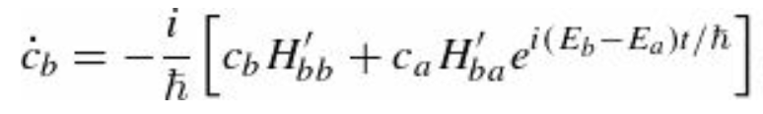
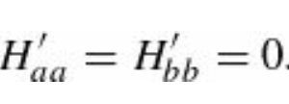
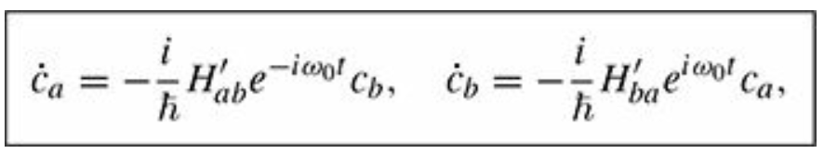
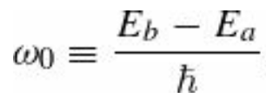
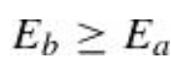
The perturbed system
Similarly, the inner product with $ψ_{b}$ picks out ${\dot{c}}_{b}$
and hence
These equations determine $c_{a}$ and $c_{b}$and taken together, they are completely equivalent to the (time-dependent)
Schrödinger equation, for a two-level system. Typically, the diagonal matrix elements of $\hat{H}′$ vanish
If so, the equations simplify:
And we assume

Slide 10
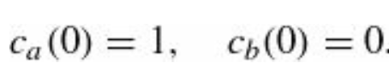
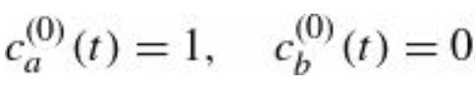
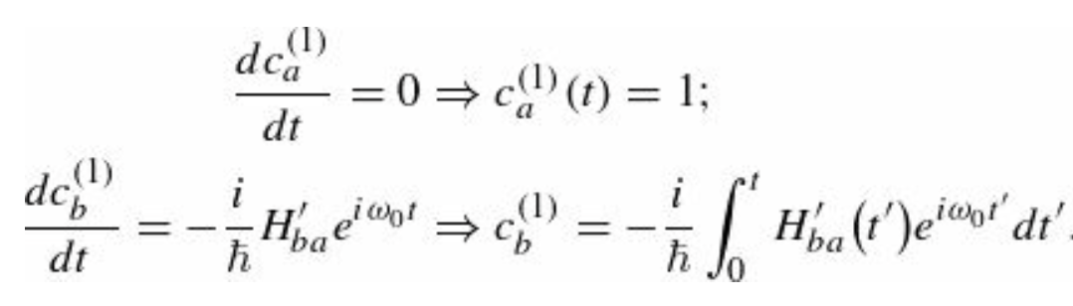
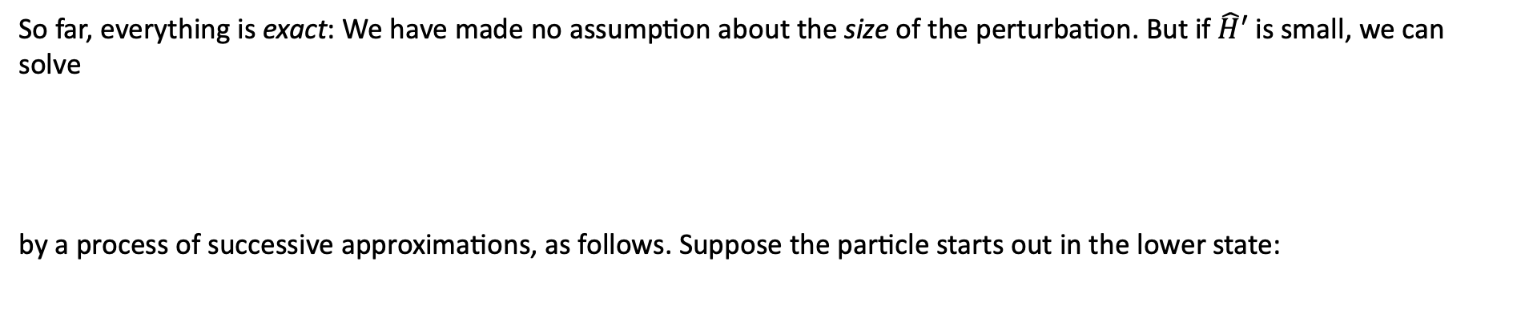

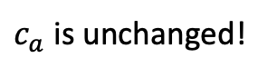
Time-Dependent Perturbation Theory
So far, everything is exact: We have made no assumption about the size of the perturbation. But if $\hat{H}′$ is small, we can solve
by a process of successive approximations, as follows. Suppose the particle starts out in the lower state:
(*)
If there were no perturbation at all (i.e., ${\hat{H}}^{′}=0$), they would stay this way forever:
Zeroth Order: (use a superscript in parentheses to indicate the order of the approximation.)
First Order: To calculate the first-order approximation, we insert the zero-order values on the right side of Eq. (*)
$c_{a}$ is unchanged!

Slide 11
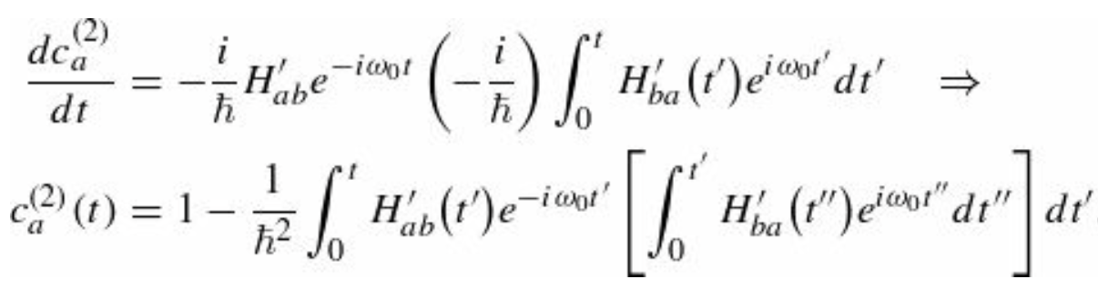
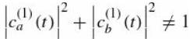
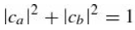
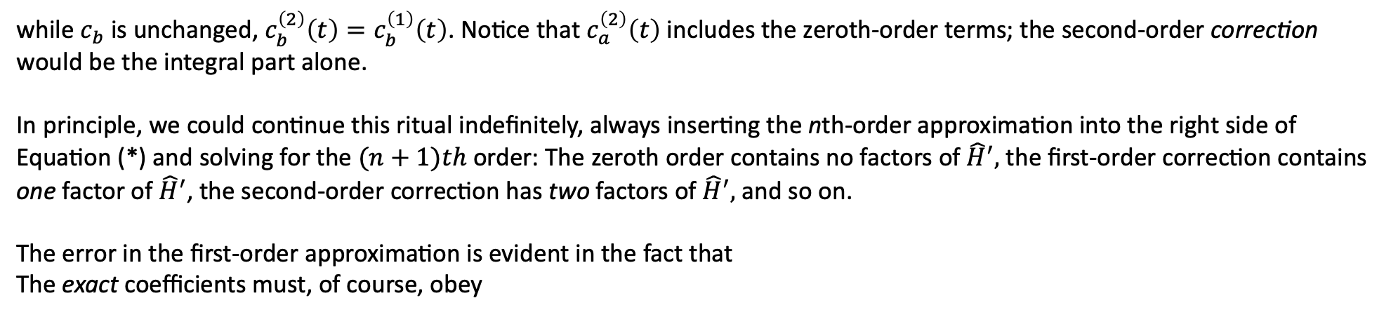
Time-Dependent Perturbation Theory
Now we insert these expressions on the right side of Eq.(*) to obtain the second-order approximation:
Second Order:
while $c_{b}$ is unchanged, $c_{b}^{\left(2\right)}\left(t\right)=c_{b}^{\left(1\right)}\left(t\right)$. Notice that $c_{a}^{\left(2\right)}\left(t\right)$ includes the zeroth-order terms; the second-order correction
would be the integral part alone.
In principle, we could continue this ritual indefinitely, always inserting the nth-order approximation into the right side of
Equation (*) and solving for the $(n+1)th$order: The zeroth order contains no factors of ${\hat{H}}^{′},$the first-order correction contains
one factor of ${\hat{H}}^{′}$, the second-order correction has two factors of ${\hat{H}}^{′},$and so on.
The error in the first-order approximation is evident in the fact that
The exact coefficients must, of course, obey

Slide 12
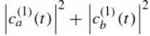

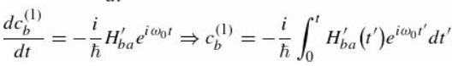
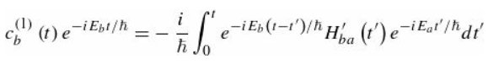
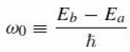
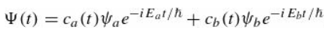
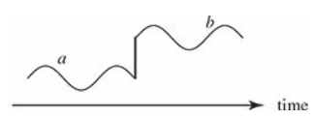
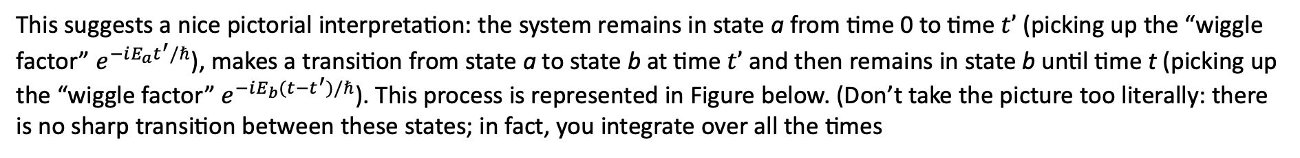
Time-Dependent Perturbation Theory
However,
is equal to 1 to first order in ${\hat{H}}^{′}$ which is all we can expect from a first-order approximation.
And the same goes for the higher orders. The equation for $c_{b}^{\left(1\right)}$ can be written as
where and we restored the exponential factor in
This suggests a nice pictorial interpretation: the system remains in state a from time 0 to time $t’$ (picking up the “wiggle factor” $e^{−iE_{a}t^{′}/ℏ}$), makes a transition from state a to state b at time $t’$ and then remains in state b until time t (picking up the “wiggle factor” $e^{−iE_{b}(t−t^{′})/ℏ}$). This process is represented in Figure below. (Don’t take the picture too literally: there is no sharp transition between these states; in fact, you integrate over all the times

Slide 13
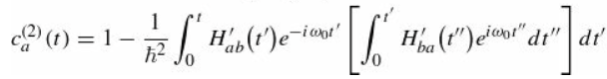
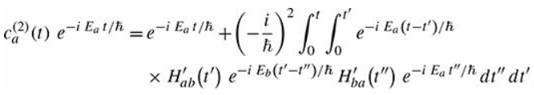
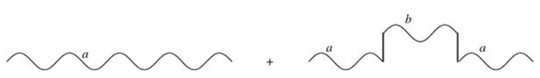
Time-Dependent Perturbation Theory
This interpretation of the perturbation series is especially illuminating at higher orders and for multi-
level systems, where the expressions become complicated. Consider the Equation for $c_{a}^{\left(2\right)}$
This can be rewritten as
The two terms here describe a process where the system remains in state a for the entire time, and a second process where
the system transitions from a to b at time $t’’$ and then back to a at time t’. Graphically, this is shown

Slide 14
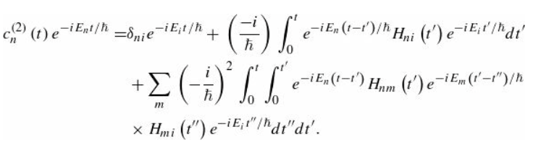
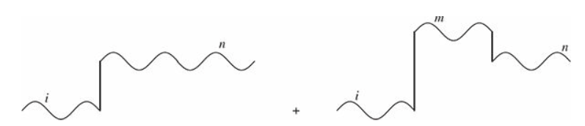
Time-Dependent Perturbation Theory
With the insight provided by these pictures, it is easy to write down the general result for a multi-level system
For $n≠i$ this is represented by the diagram in the figure below. The first-order term describes a direct transition from i to n, and the second-order term describes a process where the transition occurs via an intermediate (or “virtual”) state m.

Slide 15
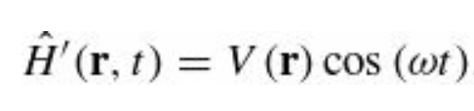
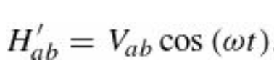
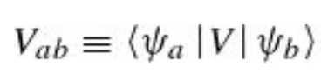
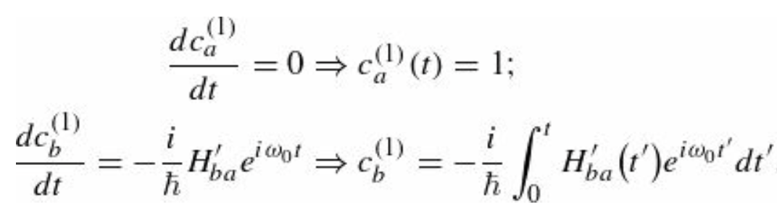
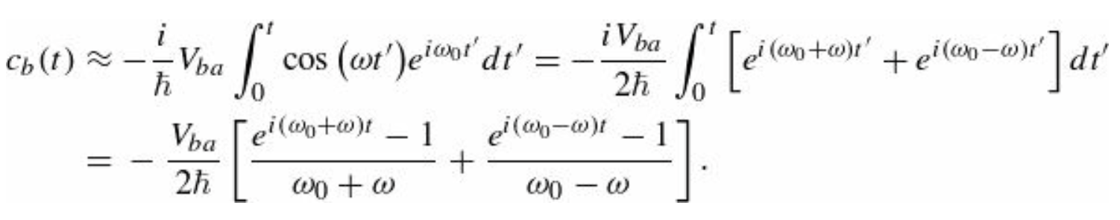
Sinusoidal Perturbations
Suppose the perturbation has sinusoidal time dependence
so that
As before, we will assume the diagonal matrix elements vanish, since this is almost always the case in practice.
To first order (from now on we’ll work exclusively in first order, and we’ll omit with the superscripts) we have that Eq (*)
gives

Slide 16



Sinusoidal Perturbations
That’s the answer, but it’s a little cumbersome to work with. Things simplify substantially if we restrict our attention to driving frequencies $ω$ that are very close to the transition frequency $ω_{0}$ so that the second term in the square brackets dominates; specifically, we assume:
This is not much of a limitation, since perturbations at other frequencies have a negligible probability of causing a transition anyway. Dropping the first term, we have
The transition probability—the probability that a particle which started out in the state $ψ_{a}$ will be found, at time t, in the state $ψ_{b}$ is

Slide 17

Sinusoidal Perturbations
The most remarkable feature of this result is that, as a function of time, the transition probability oscillates sinusoidally.
After rising to a maximum of ${\left|V_{ab}\right|}^{2}/{(ℏ}^{2}{(ω_{0}−ω)}^{2})$ —necessarily much less than 1, else the assumption that the perturbation is “small” would be invalid—it drops back down to zero! At times $t_{n}=2πn/\left|ω_{0}−ω\right|$ where $n=1,2,3,…$, the particle is certain to be back in the lower state. If you want to maximize your chances of provoking a transition, you should not keep the perturbation on for a long period; you do better to turn it off after a time $π/\left|ω_{0}−ω\right|$ and hope to “catch” the system in the upper state.

Slide 18

Sinusoidal Perturbations
The probability of a transition is greatest when the driving frequency is close to the “natural” frequency $ω_{0}$. This can be seen in the figure below, where $P_{a→b}$ is given as a function of $ω$. The peak has a height of ${\left|V_{ab}\right|}^{2}t^{2}/{(4ℏ}^{2})$ and a width
$4π/t$. Evidently, it gets higher and narrower as time goes on. (Ostensibly, the maximum increases without limit. However, the perturbation assumption breaks down before it gets close to 1, so we can believe the result only for relatively small t.
To better understand this, let us analyze an interesting example.

Slide 19



The rotating wave approximation and I.I. Rabi’s flopping frequency
The first term in
comes from the $e^{iωt}/2$ part of $\cos{(ωt)}$ and the second from $e^{−iωt}/2$. Thus, dropping the first term is formally
equivalent to writing
That is equivalent to say
The latter is required to make the Hamiltonian matrix hermitian—or, if you prefer, to pick out the dominant term in the formula analogous to the Equation above for $c_{a}(t)$.

Slide 20



The rotating wave approximation and I.I.Rabi’s flopping frequency
Isaac Rabi, noticed that if one makes this so-called rotating wave approximation at the beginning of the calculation, the system for $c_{a}(t)$ and $c_{b}(t)$can be solved exactly, with no need for perturbation theory, and no assumption about the strength of the field.
In the rotating wave approximation
(*)
becomes
(**)
Differentiating, and substituting back in (**):

Slide 21






The rotating wave approximation and I.I.Rabi’s flopping frequency
Therefore, we obtain the following differential equation of the 2nd order
Solution
Characteristic equation
with
Using these results, the general solution is written as
or, in terms of sine and cosine
where the condition $c_{b}\left(0\right)=0→C=0$
The time derivative of $c_{b}\left(t\right)$gives

Slide 22

The rotating wave approximation and I.I. Rabi’s flopping frequency
which allows us to calculate the coefficient $c_{a}(t)$
The condition $c_{a}\left(0\right)=1$ gives
Finally, the complete exact solution is given as

